Slide 1
610 Main Street Building is one block south of Main street at the intersection of Portland and Albany Streets
Service Road

Slide 2
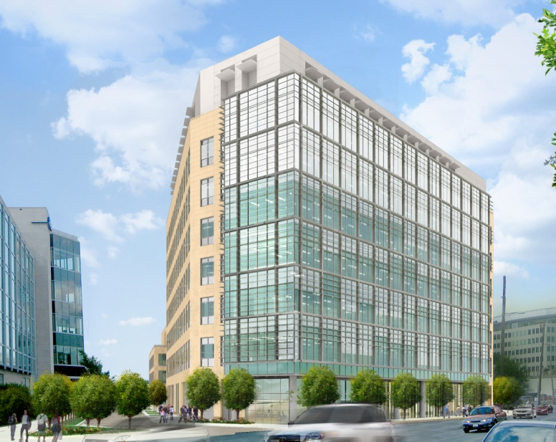
610 Main - View from Albany Street
Main entrance

Slide 3
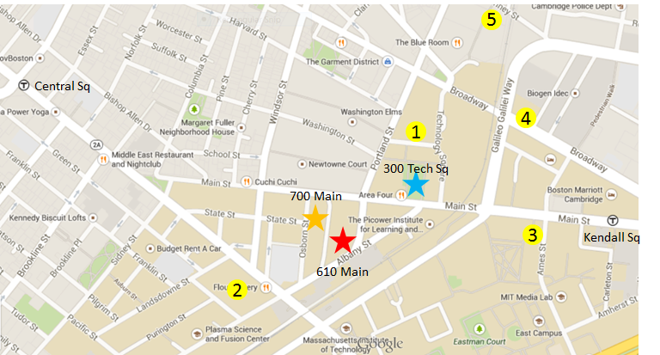
610 Main Street
(RUs, BTxLT, DSRD, PM analytical, Med Chem)
700 Main Street
(GBT, PDM)
300 Tech Square
Annex
(Clinical)
Parking
Metered parking is available on Albany and Portland Streets near main entrance
Additional parking options are available at other area lots (see map):
800 Technology Square (617) 956-1110 – Max daily rate $32, 3 hours is $22
55 Franklin Street (617) 374-7540 – Max daily rate $25, $12 after 5pm
77 Ames Street (617) 621-7618 – Max daily rate $35
10 Cambridge Center (877) 717-0004 – Max daily rate $40
389 Binney Street (617) 492-8707 – Max daily rate $32
http://en.parkopedia.com/parking/garage/technology_square_garage/02139/cambridge/

Slide 4
The Red line can be accessed from Central Parking locations (eg. Alewife, Quincy); transfers from the Green, Orange, Blue or Silver Lines; or via MBTA commuter rail services through North Station, Porter Square or South Station.

